Slide 1
Using gender data for policymaking
ASIA-PACIFIC TRAINING CURRICULUM ON GENDER STATISTICS

Slide 2
Become familiar with how to integrate a gender perspective across policymaking
Understand the need and rationale for using gender statistics in policymaking
Learn basic concepts of data and policy-integration for evidence-based policymaking
Learn key tips for writing evidence-based gender policy briefs
1
Learning objectives

Slide 3
Mainstreaming the use of gender data throughout the policymaking process
2

Slide 4
Mainstreaming the use of gender data throughout the policymaking process
“Policymaking is the practice of making tangible written rules that govern a group of people or society at large”
Evidence-based policymaking might occur by:
Identifying a policy issue and then gathering evidence to fully understand it
Findings from data analysis highlight an issue, and a policymaking process begins as a result
Why use GENDER DATA in policymaking?
Data-informed decisions promote policy effectiveness
Can promote targeted responses to issues
Good statistics lead to good policies → better development
To achieve the SDGs

Slide 5
Mainstreaming the use of gender data throughout the policymaking process
A gender perspective needs to be integrated across all stages of policymaking
Identifying the issue
Gathering evidence
Identifying and defining outcomes
Planning
Communication
Implementation (and monitoring)
Reporting

Slide 6
Mainstreaming the use of gender data throughout the policymaking process
Identifying the issue
A fact or statistic can reveal an aspect of social/economic life that requires attention
Use statistics to identify the realities of different population groups (e.g. some women and girls lagging behind in areas of well-being)
2. Gathering evidence
Examine gender data, including disaggregated by age, race, ethnicity or other socioeconomic variables
Assess the quality of the data by looking at the metadata
Organize user-producer dialogues if users need to request further analysis or to understand and interpret the existing data correctly

Slide 7
Mainstreaming the use of gender data throughout the policymaking process
3. Identifying and defining outcomes:
Use gender data to answer the following questions:
What is the issue that this policy should resolve?
What are the population groups for which the policy should create change?
What is the status of these groups in relation to the desired goal?
Are women and men equally disadvantaged on this issue?
Are any of these population groups (e.g. specific groups of women or men) particularly at risk/disadvantaged?
What degree of change is realistic for each group, given the current status and the time frame?
Are there any gender-specific factors that might hinder the achievement of the outcome? (e.g. pregnancy, safety in public spaces, care responsibilities, etc.)
Identify multiple outcomes to meet the needs of the multiple population groups

Slide 8
Mainstreaming the use of gender data throughout the policymaking process
4. Planning
Make sure policy objectives and outcomes are well-aligned
When selecting policy responses to the issues, ask:
Will the same policy approach work for women and men?
Will it work for all population groups in need?
Could there be any negative externalities as a result?
Will it affect other people or natural resources?
Select gender-sensitive performance indicators to monitor progress (at the output, outcome and impact levels – see next slide)
To capture gender dimensions, two types of indicators can be used:
Indicators disaggregated by sex
Indicators capturing gender-specific issues without disaggregation

Slide 9
Mainstreaming the use of gender data throughout the policymaking process
Indicators can be designed at three levels:
Output
Concerned with ‘what’ the policy produces
Directly determined by the policy actions/activities
Usually explicit and certain
Outcome
Concerned with conditions that should be altered by a policy
Affected only after policy outputs are achieved
Less certain, as compared to output indicators
Impact
Measure long-term direct/indirect effects of policy outcomes
May or may not even occur
E.g. Proportion of young professionals who are skilled in computer literacy, by sex
E.g. Unemployment rate, by sex
E.g. Gross domestic product

Slide 10
Mainstreaming the use of gender data throughout the policymaking process
5. Communication:
Important to convince stakeholders to take action
Tailored communication strategies for different stakeholders
6. Implementation (and monitoring):
Be conscious of gender bias
Gender-sensitization training for policy-implementation personnel
Use gender data to monitor the pace and results of policy implementation
7. Reporting:
Policy reports should be publicly available and easily accessible
Reports in different formats and media
Statisticians must support policymakers in producing progress & final reports

Slide 11
3
How to use gender statistics for policymaking

Slide 12
How to use gender statistics for policymaking Using gender statistics to set the agenda
1. Using gender statistics to set the agenda:
Existing gender data can help identify significant issues, needs and challenges
Data disaggregation beyond sex may reveal inequalities
E.g. Disaggregation by ethnicity, religion, region, marital status, etc. might highlight groups of women lagging behind
Policy makers must collaborate with national statisticians to:
Understand and interpret gender data accurately
Understand the pros and cons of different sources of data (official vs non-official)
Target population groups should be consulted to complete the evidence-gathering process prior to policy forumulation

Slide 13
Using gender statistics to design key policy components
2. Using gender statistics to design key policy components:
Empirical research findings can help shape policies
E.g. who will be the beneficiary of the policy, or to set benchmarks for policy objectives
Statistical analysis to support policy design:
Regression analysis to develop scenarios to see how a policy can alter the status quo
Correlation analysis to help identify potential negative externalities
Statistical projections to determine realistic outputs given the time frames
If enough good-quality data is not available for policy design, user-producer dialogue can:
Design future data collection exercises
Advocate for more resources to be allocated towards gender statistics
Select indicators based on relevance and in line with policy outputs, outcomes and impact

Slide 14
How to use gender statistics for policymaking: Writing policy briefs
2.1 Writing policy briefs
A policy brief is a document that outlines the rationale for choosing a course of action in a policy debate
A gender-related policy brief can be structured in six sections:
1. What is the issue?
2. What is the goal?
3. Why bother?
4. Measuring progress
5. Interventions/Recommendations
6. Footnotes/ References

Slide 15
How to use gender statistics for policymaking: Writing policy briefs
1. What is the issue?
Quick snapshot of policy area
Current status and trends
Highlights the connection to gender equality
2. What is the goal?
Based on gender data and qualitative evidence
Highlights the main goal(s) of policy
3. Why bother?
Present arguments for a certain policy course and gender-mainstreaming approach
Include gender data to forecast and measure potential outcomes

Slide 16
How to use gender statistics for policymaking: Writing policy briefs
4. Measuring progress or stagnation?
Data is used to showcase status or progress towards policy goals
Mix and match three types of indicators:
Boolean indicator: Measure the status of policy or action as ‘Yes’ or ‘No’
Numerical indicator: Measure changes using statistical data
Qualitative indicator: Provide qualitative information based on sociological surveys
Indicators should have well-defined methodology to ensure comparability
5. Possible interventions and recommendations
Possible solutions from a gender perspective
Highlight interventions that fall under the government’s mandate but mention other stakeholders too
6. Footnotes and references
At the end, to clarify concepts and point to information sources

Slide 17
How to use gender statistics for policymaking: Writing policy briefs
What makes a good policy brief?
Focused: focus on convincing the target audience
Professional, not academic: statements regarding new evidence should be insightful and highlight results rather than methods of analysis
Evidence-based: Gender data should be used to highlight the problem and potential consequences of pursuing different interventions
Limited: Focus on one particular problem or area of a problem
Succinct: Do not exceed 2 to 8 pages in length (i.e. usually not longer than 3,000 words)
Understandable: Provide a well-explained and easy-to-follow argument targeting the audience’s knowledge and skills.

Slide 18
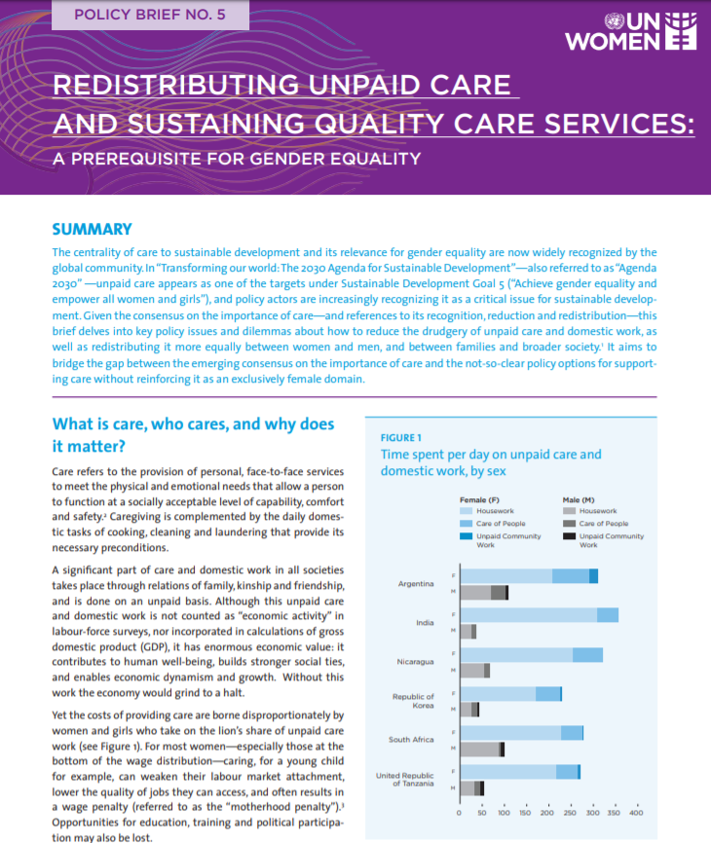
How to use gender statistics for policymaking
Example of a policy brief: UN Women. 2016.
- Policy briefs should be succinct and short.
- Summarize the content in the beginning to provide an overview.
Replace texts with visuals
Tailor the level of complexity according to the audience.
- Justify why the issue is important.
- Substantiate the justification with evidence
- Women/girls-men/boys data visuals can convey messages around disparity in a quick and engaging way

Slide 19
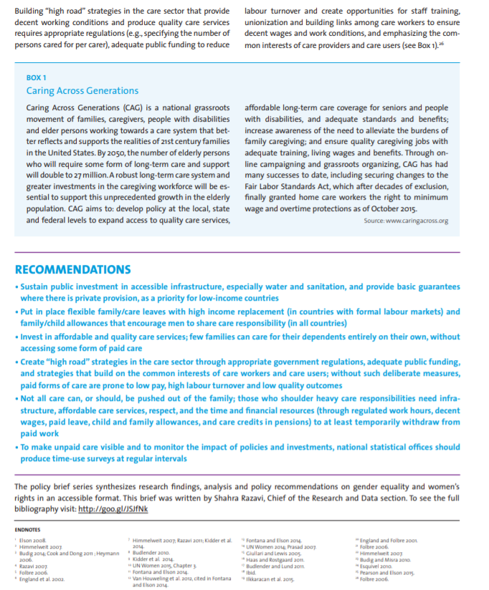
How to use gender statistics for policymaking
Example policy brief: UN Women. 2016. (contd.)
Evidence of success stories to back the justification for a policy suggestion
Policy recommendations:
- Focused
- Professional
- Evidence-based
- Limited
- Succinct
- Understandable
- Accessible
- Flashy
Include key references at the end

Slide 20
How to use gender statistics for policymaking
3. Using gender statistics to monitor and evaluate policies
Monitoring is done during and after the policy implementation
Need indicators to monitor inputs, outputs and outcomes of policies
3.1 Using EPIC to develop indicator set for policy monitoring
EPIC is a data-policy integration tool; facilitates dialogue between data producers and policymakers
Identifies indicators and disaggregated variables through content analysis of policy documents
Overarching steps of this analysis:
Identify potential members to form a team for analysis: range of data users and producers
Identify policy document for analysis: National development strategy; national gender equality strategy, etc.
Map with existing indicators at national/regional/global levels: Key issues in the document will be matched with indicators and target groups with disaggregation variables

Slide 21
Overcoming barriers to evidence-based decision- making
4

Slide 22
Overcoming barriers to evidence-based decision-making
Understand and appreciate data better:
Statistical literacy trainings for policymakers
Policymakers to consistently check the quality of gender data sources
User-producer dialogues to align needs with supply
Build institutional bridges to strengthen policy-data integration:
Discussion forums, joint trainings and coordination groups
Data producers as collaborators (rather than ad-hoc suppliers)
Better communicate data:
Targeted and user-friendly messages facilitate data use for decision-making
Incentivize evidence-based policymaking:
E.g. Giving the control of budget to front-line ministries at the local level has incentivized these bodies in the UK to use sound evidence for resource allocation and services

Slide 23
5
Key takeaways

Slide 24
Key takeaways
Gender data needs to be integrated at all stages of policymaking.
Gender statistics can be used to decide on priority thematic areas and populations of interest within countries.
The extent to which gender data is used for policymaking depends on the availability, reliability accessibility and user-friendliness of the data.
A good gender-focused policy brief must highlight the trends and gender issues, summarize the main goal or goals to be achieved, argue for the importance of the issue and highlight why gender should be mainstreamed in the policymaking process.
The EPIC tool can be used to develop a gender-specific set of indicators for policy monitoring.
Policymakers need to understand the value of evidence and become more engaged in interpreting and using evidence.
Gender data needs to be better communicated and tailored for policymakers and other stakeholders to ensure its widespread use for policymaking.
Incentives must be put in place to encourage de use of gender data for policymaking.

Slide 25
THANK YOU

